Slide 1
Home Automation Using Python
SlideMake.com

Slide 2
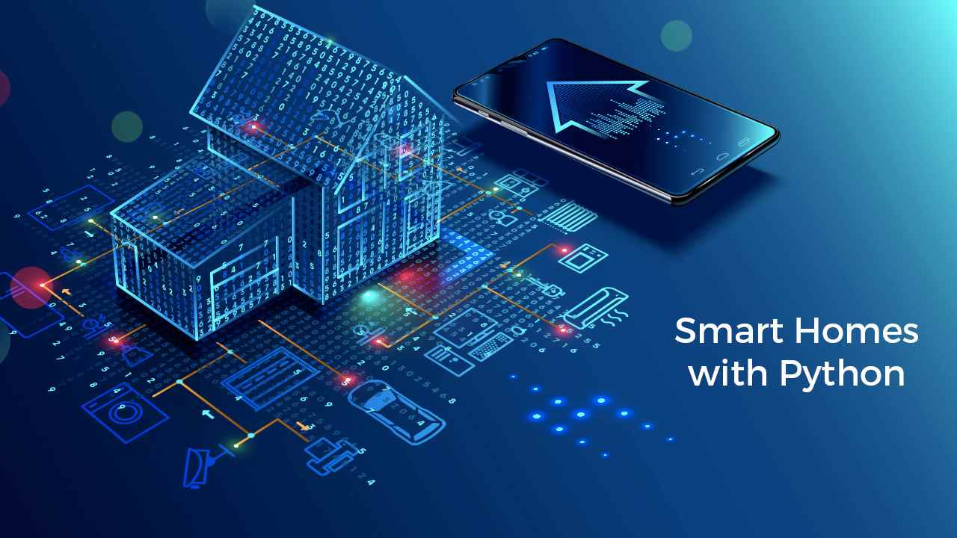
Introduction to Home Automation with Python
Home automation refers to the control of home appliances through a centralized system.
Python is a versatile programming language that simplifies the automation process due to its rich libraries and frameworks.
By leveraging Python, users can create customized home automation solutions that enhance convenience and energy efficiency.
Notes:
Image source: https://www.activestate.com/blog/how-to-automate-your-home-with-python/

Slide 3
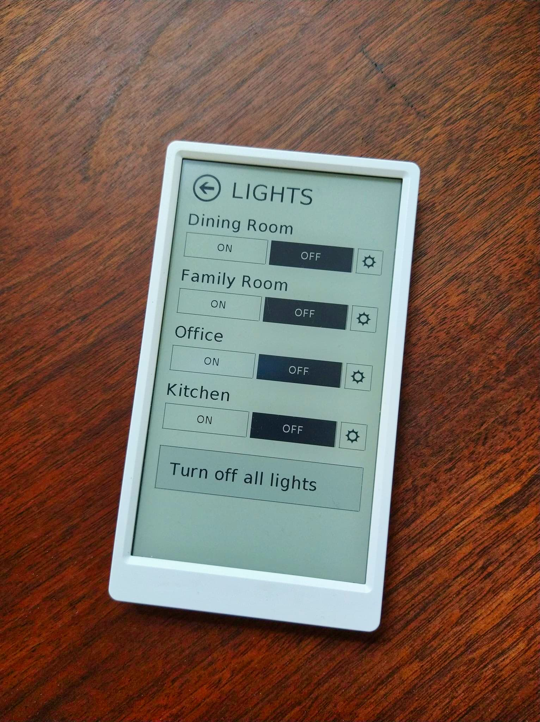
Key Libraries and Frameworks
The Home Assistant framework is popular for building smart home applications with Python.
Libraries like Flask and Django can be used to create web-based interfaces for controlling smart devices.
Additionally, MQTT and other communication protocols facilitate seamless device interaction within a home automation system.
Notes:
Image source: https://community.home-assistant.io/t/m5paper-e-ink-home-assistant-remote-building-an-expandable-framework/448058

Slide 4
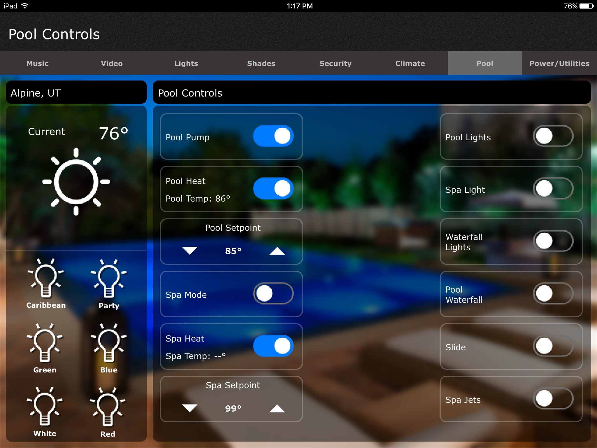
Common Use Cases
Automated lighting systems can be programmed to adjust based on time of day or occupancy.
Smart thermostats can learn user preferences and manage heating and cooling for optimal energy savings.
Security systems can be enhanced with Python to include features like real-time alerts and remote monitoring.
Notes:
Image source: https://www.reedsbuiltins.com/smart-home-automation/

Slide 5
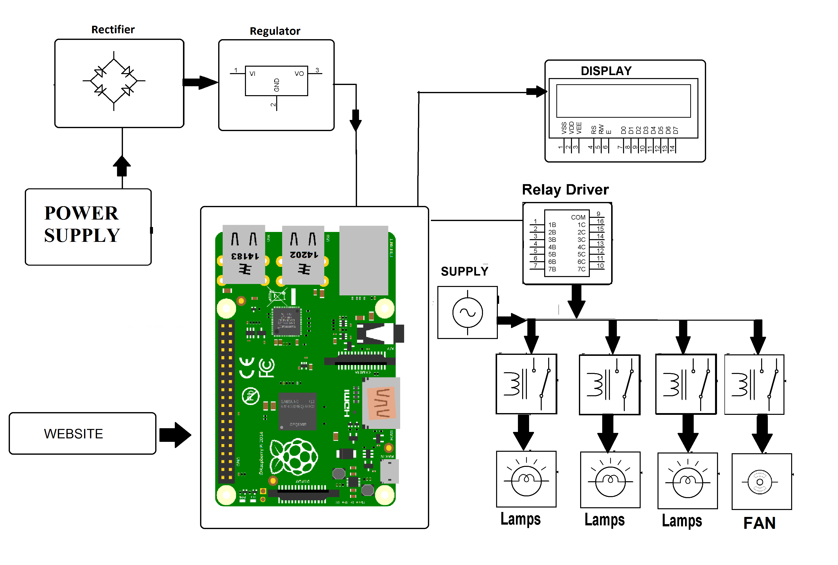
Getting Started with Python Home Automation
Setting up a Raspberry Pi is a great way to begin experimenting with home automation projects.
Users can explore online resources and tutorials to learn how to integrate various smart devices with Python.
The community surrounding Python home automation is vibrant, offering forums and support for troubleshooting and project ideas.
Notes:
Image source: https://www.raspberrylovers.com/2019/07/python-code-for-home-automation-using.html

